Slide 1
PROFESSIONAL COMMUNICATION
Name: Sayan ghosh; Sec: (gamma)
stream: bca (2nd year); sem: 3rd
paper name: professional communication
paper code: ge1b-19
university roll no: 15201222165
TOPIC: HARD SKILLS & SOFT SKILLS

Slide 2
CONTENTS:
1.introduction to hard skills and soft skills.
2.overview and examples of hard skills & soft skills.
3.APPLICATION OF HARD SKILL AND & SOFT SKILL IN TERMS OF EMPLOYABILITY AND CAREER.
4.GROOMING AS PROFESSIONAL WITH SOFT SKILLS.
5.SUMMARY & CONCLUSION.

Slide 3
1.INTRODUCTION TO HARD SKILLS & SOFT SKILLS
HARD SKILLS REFER TO THE JOB-RELATED KNOWLEDGE AND ABILITIES THAT EMPLOYEES NEED TO PERFORM THEIR JOB DUTIES EFFECTIVELY.
ON THE OTHER HAND, SOFT SKILLS ARE THE PERSONAL QUALITIES THAT HELP EMPLOYEES REALLY THRIVE IN THE WORKPLACE.

Slide 4
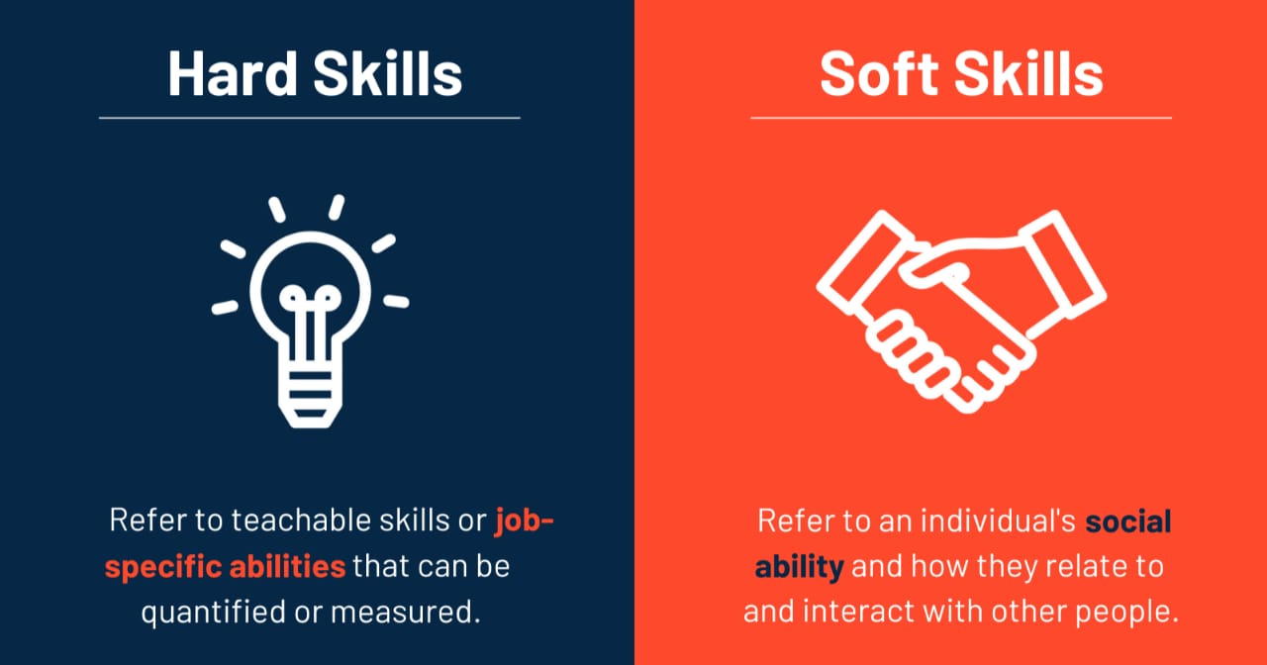
2.OVERVIEW &AND EXAMPLES OF HARD SKILLS AND SOFT SKILLS :
HARD SKILLS ARE USUALLY OBTAINED THROUGH HANDS ON EXPERIENCE OR EDUCATION.
ON THE OTHER HAND, SOFT SKILLS ARE MORE AKIN TO PERSONALITY TRAITS THAT YOU HAVE NATURALLY DEVELOPED THROUGHOUT YOUR LIFE.
FOR EXAMPLE :
A HARD SKILL WOULD BE CODING .NO ONE IS BORN WITH THE INSTINCT TO CODE.

Slide 5
3.APPLICATION OF HARD SKILL AND & SOFT SKILL IN TERMS OF EMPLOYABILITY AND CAREER :
HARD SKILLS are abilities you learn in school or on job. They are things like c programming , marketing campaign management , and financial forecasting.
soft skills are traits that make you a good worker . they are things like work ethic, organization, communication ,collaboration and leadership.

Slide 6
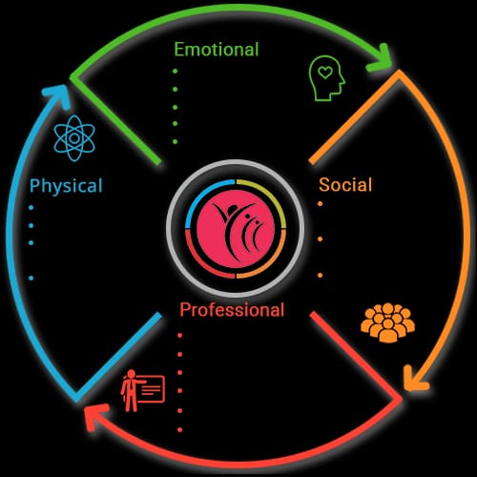
4.GROOMING AS PROFESSIONAL WITH SOFT SKILLS :
Soft skill grooming is the process of developing and strengthening your interpersonal communication, problem-solving and critical thinking skills. It is an important part of personal and professional development, as it helps you to build relationships, lead effectively, handle difficult conversations and succeed in the workplace

Slide 7
5.SUMMARY & CONCLUSION :
Hard skills are easy to measure and define, while soft skills are a bit more nebulous. Hard skills are those talents and abilities that can be measured. They are usually specific to a particular job, and they can be learned through schooling or on-the-job training. Soft skills are less defined skills that often apply not only to one specific job but are universal. Some recruiters or HR personnel might define these vaguely as “people skills.” Think of empathy, creativity, adaptability, and collaboration.
Hard skills are often those you list on a resumé or the areas in which you hold certifications. Soft skills are those that help you build longer-lasting coworker and customer relationships. The importance of hard skills vs. soft skills should not be underestimated.

Slide 8
END

